Slide 1
CSE 495B Lecture 12
Efficient Fine-tuning techniques

Slide 2
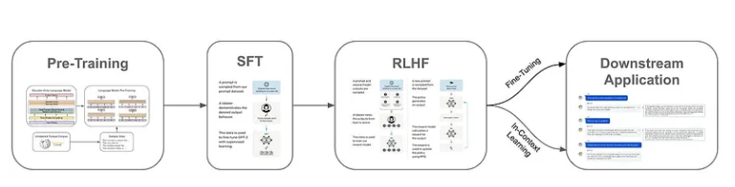
LLM preparation steps
Pretraining: All language models are pretrained using some form of a self-supervised learning objective.
Generative language models are usually pretrained using a next token prediction objective, while encoder-only and encoder-decoder models commonly use a Cloze task

Slide 3
LLM preparation steps
Alignment: The alignment process, which is only applicable to generative LLMs, refers to the process of finetuning a language model such that its output aligns with the expectations of human users.
To perform alignment, we first define several criteria (e.g., helpfulness, harmlessness, the ability to follow instructions, etc.) that we want to instill within the model.
Finetuning. After pretraining and alignment (i.e., an optional step for generative LLMs), we have a generic foundation model that can be used as a starting point for solving many tasks.
To solve a task, however, we must adapt the language model to this task, usually via finetuning (i.e., further training on data from a task).

Slide 4
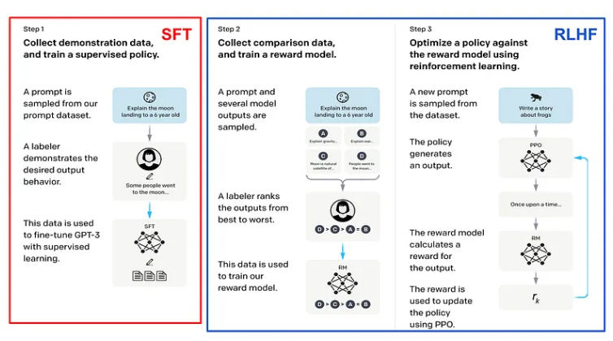
Fine tuning process

Slide 5
Fine tuning LLMs
How can we train a specialized LLM over our own data?
LLMs are powered by massive models with many parameters.
Training such an LLM requires expensive hardware (i.e., many expensive GPUs with a lot of memory) and fancy training techniques (e.g., fully-sharded data parallel training).
To reduce the complexity, these models are usually trained in two phases — pretraining and finetuning — the pretraining phase being more expensive while finetuning is cheaper (and more frequent).
Given that high-quality pretrained LLMs are readily available online, most AI practitioners can simply download a pretrained model and focus upon adapting this model (via finetuning) to their desired task.

Slide 6
Fine tuning LLMs
Fine-tuning enormous language models is prohibitively expensive in terms of the hardware required and the storage/switching cost for hosting independent instances for different tasks.
The size of the model does not change during finetuning!
As a result, finetuning an LLM — though cheaper than pretraining — is not easy.
We still need training techniques and hardware than can handle such a model.
And every finetuning run creates an entirely separate “copy” of the LLM that we must store, maintain, and deploy — this can quickly become both complicated and expensive!

Slide 7
Challenges to fine tuning
Although finetuning is computationally cheap relative to pretraining or training from scratch, it can still be quite expensive, especially for the massive generative LLMs
We need to consider the efficiency from a compute and memory perspective, allowing practitioners to train specialized LLMs with fewer/smaller GPUs and less investment of time and money.

Slide 8
PEFT
Instead of training the full model end-to-end, parameter-efficient finetuning leaves pretrained model weights fixed and only adapts
A small number of task-specific parameters during finetuning.
Such an approach drastically reduces memory overhead, simplifies the storage/deployment process, and allows us to finetune LLMs with more accessible hardware.

Slide 9
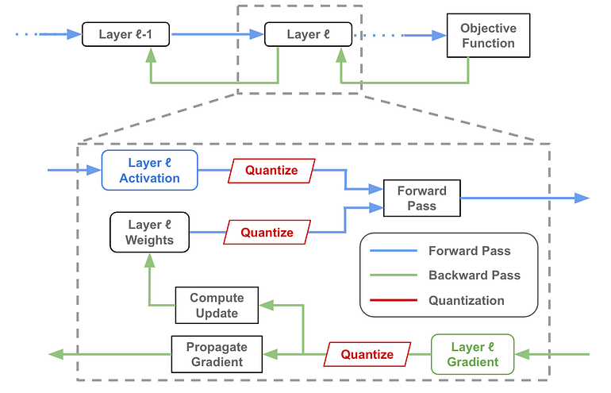
Model Quantization

Slide 10
Quantization
Quantization is a model compression technique that maps high-precision values to lower-precision representations.
For large language models (LLMs), this typically involves reducing the precision of weights and activations, which makes the model significantly less memory intensive.
However, quantization can affect the model’s capabilities, particularly accuracy.
As a result, it is generally treated as a trade-off, where the degree of quantization depends on the specific use case.
In many cases, it has been shown that comparable performance can be achieved even at much lower precision, making quantization a highly effective optimization strategy.
Beyond reducing model size, quantization improves performance by lowering memory bandwidth requirements and enhancing cache utilization, which leads to faster and more efficient inference.

Slide 11
How to quantize?
Large Language Models (LLMs) are typically trained using either full precision (FP32, 32-bit floating point) or half precision (FP16, 16-bit floating point).
Storage requirement: A single FP16 number uses 16 bits (2 bytes).
Thus, a model with one billion parameters stored in FP16 requires approximately 2 GB of memory.
Quantization process: Quantization reduces precision by mapping the full range of FP32 weight values to lower-precision formats such as FP16, INT8, or even INT4.
For example, a common case is compressing from FP32 to INT8, which reduces storage by 4× while still preserving much of the model’s representational power.
Impact on quality: The effect of quantization on model accuracy depends heavily on the specific quantization technique employed (e.g., post-training quantization vs. quantization-aware training).
Well-designed methods can retain performance close to the original model while significantly reducing memory and compute requirements.

Slide 12
Quantize What?
Weights: Quantizing model weights is the most common and widely used approach.
Reduces model size, memory consumption, and storage requirements, making deployment more efficient.
Activations: In practice, activations often dominate memory usage.
Quantizing activations can significantly reduce memory demand.
If combined with weight quantization, it enables full integer computation, leading to substantial performance gains.
KV Cache: For sequence generation tasks, quantizing the key–value (KV) cache is critical.
Reduces memory overhead and improves throughput, especially for models handling long context windows.
Gradients: Gradient quantization is less common, as gradients are primarily used during training.
Since gradients are typically stored in floating-point format, quantization here is mainly applied to lower communication overhead in distributed training and reduce memory costs during the backward pass.

Slide 13
Types of Quantization
Proposed techniques using quantization can be (roughly) categorized into three primary areas:
Quantized Training: perform quantization during training to make the training process more efficient.
Post-Training Quantization: quantize a model weights after training to make inference more efficient.
Quantization-Aware Training: train in a manner that makes the model more amenable to quantization, thus avoiding performance degradations due to post-training quantization.

Slide 14
Automatic mixed precision
Automatic Mixed Precision (AMP) enables training of neural networks by dynamically using lower precision (e.g., FP16) in parts of the computation graph while retaining higher precision (e.g., FP32) where necessary to preserve numerical stability.
Hardware & Software Support: AMP requires compatible hardware (such as NVIDIA Tensor Cores) and appropriate driver/software support (CUDA and cuDNN).
NVIDIA GPUs provide full support for AMP.
Performance Benefits: By leveraging reduced precision arithmetic in safe regions of the network, AMP can significantly accelerate training—often cutting training time by up to 50%—while maintaining model accuracy comparable to full FP32 training.
Ease of Integration: NVIDIA’s AMP package is seamlessly integrated into widely used deep learning frameworks such as PyTorch and TensorFlow. In addition, Hugging Face provides native options for mixed-precision training, making it straightforward to adopt without major code modifications.

Slide 16
Finetuning: In-Context Learning (Prompts)
Pretrained LLMs possess basic capabilities for solving problems through prompting, but their raw responses are often inconsistent, shallow, or misaligned with human intent.
The alignment process (e.g., reinforcement learning with human feedback, supervised fine-tuning) enhances their ability to follow instructions reliably. This process makes the model significantly more effective at solving tasks via in-context learning.
In-context learning (ICL) refers to the ability of a single model to handle a wide range of problems simply by providing carefully designed prompts, rather than retraining or fine-tuning the model for each new task.
In practice, this means the model adapts to new instructions by conditioning on the examples or descriptions provided in its input.

Slide 17
Finetuning: In-Context Learning (Prompts)
For example:
Zero-shot prompting: Asking, “Translate this sentence from English to French: ‘How are you?’” without providing examples.
One-shot prompting: Giving a single demonstration, such as: “Translate English to French. Example: ‘Good morning’ → ‘Bonjour’. Now translate: ‘How are you?’”
Few-shot prompting: Supplying several examples of translations before presenting the target sentence, so the model can infer the pattern.
These prompting strategies represent different ways of leveraging the same pretrained model for varied tasks, without modifying its parameters.
Ultimately, alignment makes models more sensitive to instructions, while prompting methods allow users to unlock broader functionality without additional fine-tuning.

Slide 18
Prompting
Since no fine-tuning is required, and a single model can be applied across many tasks, in-context learning (ICL) is by far the most convenient way to adapt an LLM to downstream tasks. It allows rapid experimentation and deployment simply by modifying the prompt.
However, ICL typically underperforms compared to fine-tuning, especially on specialized or domain-specific tasks. As a result, fine-tuning remains the standard approach for building high-performance, task-optimized LLMs in practice.
When in-context learning does not achieve the desired level of performance, the next step is to fine-tune the model on a curated dataset, enabling it to adapt its parameters more deeply to the target domain or application.

Slide 19
Full finetuning
Full fine-tuning becomes increasingly impractical when:
The model needs to be retrained frequently (e.g., to incorporate new data), or
The same base model is fine-tuned separately for many different tasks.
In such scenarios, each fine-tuned variant is essentially a full copy of the original large model, leading to significant storage and deployment overhead.
Managing multiple instances of multi-billion parameter models not only consumes enormous disk space but also complicates version control, distribution, and serving infrastructure.
This scalability issue is one of the main motivations behind parameter-efficient fine-tuning (PEFT) methods, which aim to adapt models for new tasks without duplicating their full parameter set.

Slide 20
Adapter Layers and Prefix Tuning
Instead of fine-tuning all model parameters, we can adapt only a small subset of the existing parameters—or introduce a small number of additional trainable parameters—during fine-tuning.
With this approach, each task-specific model requires storing only a lightweight set of parameters, dramatically reducing both the compute and memory overhead of fine-tuning while simplifying deployment.
At inference time, the base pretrained model remains shared across tasks, and only the compact task-specific parameters need to be loaded.
Before the introduction of LoRA (Low-Rank Adaptation), two primary parameter-efficient fine-tuning (PEFT) techniques were widely used:
Adapter layers – inserting small trainable modules between existing transformer layers.
Prefix tuning – prepending a small set of trainable vectors (soft prompts) to the input sequence to steer the model’s behavior.

Slide 21
Adapter layers
Adapter layers are inserted as two extra adapter blocks into each transformer block.
Each adapter block is a bottleneck-style feedforward module that
Decreases the dimensionality of the input via a (trainable) linear layer
Applies a non-linearity, and
Restores the original dimensionality of the input via a final (trainable) linear layer.
Put simply, the adapter blocks are extra trainable modules inserted into the existing transformer block
Adapter blocks are inserted after both attention and feedforward layers — that have a small number of parameters and can be finetuned while keeping the weights of the pretrained model fixed

Slide 22
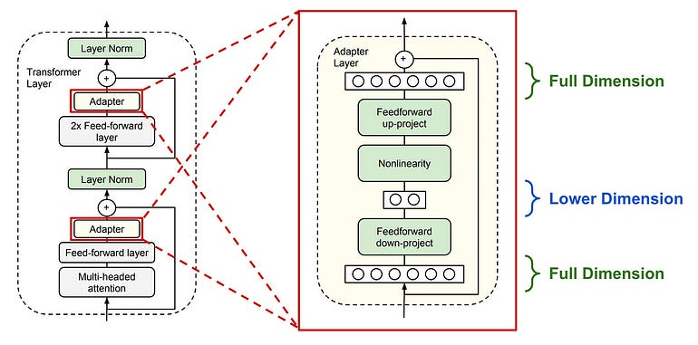
Adapter Layers

Slide 23
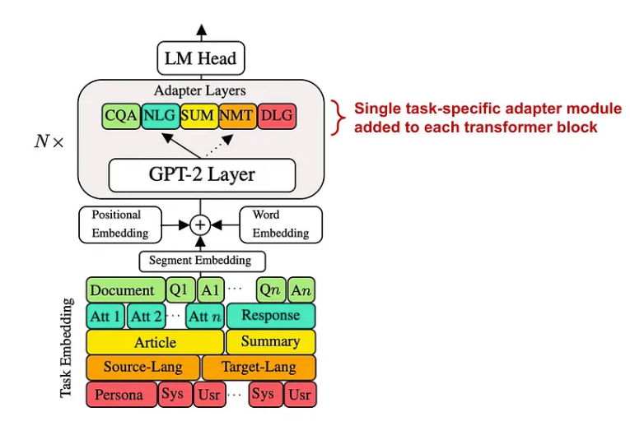
Adapter Layers

Slide 24
Prefix tuning
Prefix Tuning is a parameter-efficient fine-tuning (PEFT) method where the pretrained language model’s weights remain frozen, and only a small set of trainable prefix vectors (sometimes called “virtual tokens”) are learned.
How it works:
Instead of changing the input text itself, prefix tuning introduces a sequence of trainable vectors that are prepended to the key–value pairs inside each transformer layer.
These vectors act as task-specific “instructions” that guide the model’s attention patterns without modifying its original parameters.
Difference from prompt tuning:
Prompt tuning adds trainable embeddings only at the input layer (similar to prepending soft tokens to the input text).
Prefix tuning injects trainable vectors into the attention mechanism of every transformer layer, which typically provides stronger control and expressivity.
https://arxiv.org/pdf/2101.00190

Slide 25
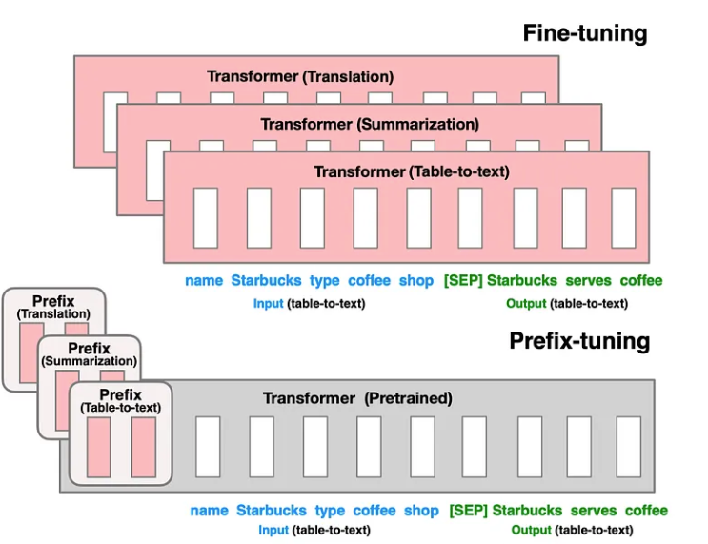
Prefix tuning

Slide 26
Finetuning LLMs Efficiently
We need a finetuning approach that is not just parameter efficient, but also:
Compute efficient: the training process should be fast and cheap.
Memory efficient: we should not need massive GPUs to finetune an LLM.
Easy to deploy: we should not have to deploy several copies of an LLM for each task that we want to solve.

Slide 27
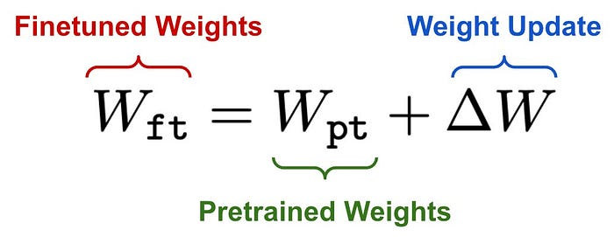
LoRA
We can formulate the parameter update derived from finetuning as shown in the equation below.
The update (ΔW) matrices have the same dimension as the original one
Billions of weight values to update

Slide 28
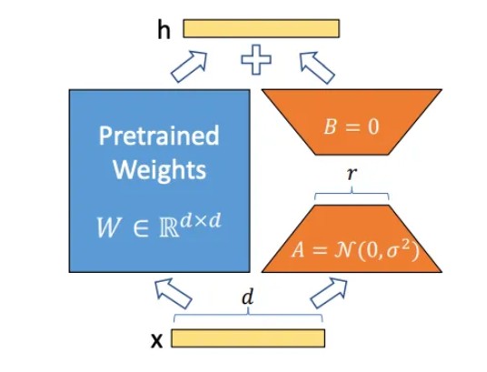
LoRA
The idea of LoRA is add adapters during fine-tuning
The adapters use a low-ranked version of the original weight matrices

Slide 29
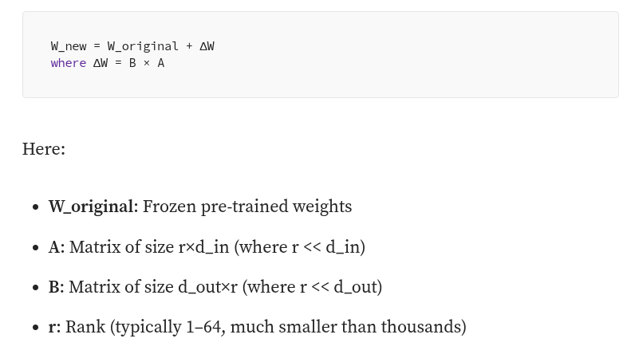
LoRA
LoRA (Low-Rank Adaptation) operates on a simple but powerful hypothesis
The weight updates needed for task adaptation have low intrinsic rank.
Instead of updating the entire weight matrix W, LoRA learns a low-rank decomposition of the weight update.

Slide 30
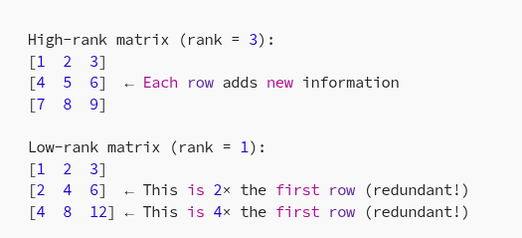
Matrix Rank
Most information in the low-rank matrix can be represented using just the first row. The other rows are “predictable” from it.

Slide 31
Why Low Rank?
When adapting a pre-trained model to a new task, we are not teaching it completely new knowledge
We are adjusting how it processes information it already understands.
Most task adaptations follow predictable patterns: emphasizing certain features, combining existing representations differently, or adjusting decision boundaries.
These changes don’t require independent updates to every single parameter. Instead, they follow common “directions” in the parameter space, which can be captured efficiently by low-rank matrices that learn these shared adaptation patterns.

Slide 32
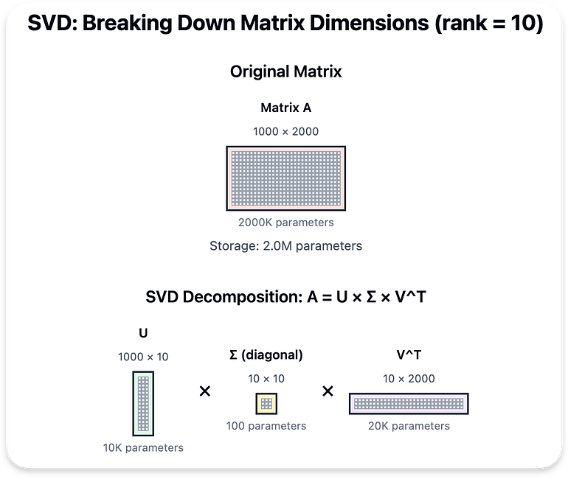
Dimensionality/Parameters Reduction
Original 2 million parameters
Around 10K+100+20K = 30100 parameters

Slide 33
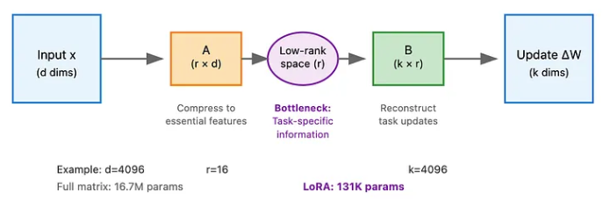
LoRA
The BA decomposition acts as an information bottleneck:
A compresses the input into a low-dimensional representation (rank r)
This forces the model to find the most important directions for the task
B then expands back to the output dimension
This bottleneck forces efficiency — the model must learn what really matters for the task.

Slide 34
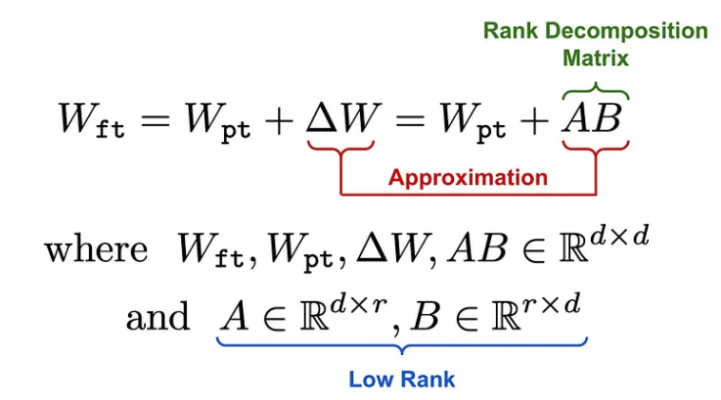
LoRA (using Matrix operations)

Slide 35
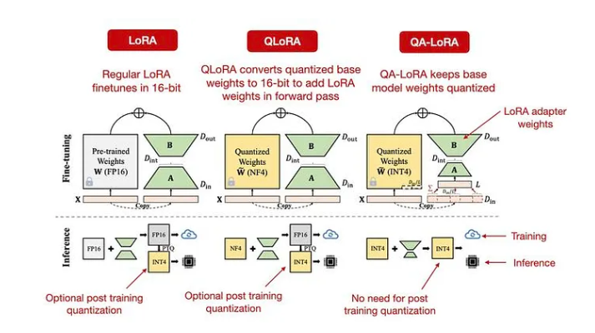
LoRA Variants

Slide 36
QLoRA
QLoRA uses 4-bit quantization on the pretrained model weights and trains LoRA modules on top of this.
The authors of QLoRA proposed several novel quantization techniques for further reducing memory usage:
4-Bit NormalFloat (NF4) Format: a new (quantized) data type that works better for weights that follow a normal distribution.
Double Quantization: reduces memory footprint by quantizing both model weights and their corresponding quantization constants.
Paged Optimizers: prevents memory spikes due to gradient checkpointing that cause out-of-memory errors when processing long sequences or training a large model.
In practice, QLoRA saves memory at the cost of slightly-reduced training speed.
For example, replacing LoRA with QLoRA to finetune LLaMA-2–7B reduces memory usage by 33% but increases wall-clock training time by 39%.

Slide 37
LoRA Variants
LoRA: Adapt to a small, low-rank subset of parameters of a base LLM.
QLoRA: Lower memory requirements even further by quantizing the base model weights. Keep the weight not-quantized.
QALoRA: Also quantize the LoRA (adapter) weights, avoiding a costly conversion of the QLoRA quantized base model weights back into 16-bit when adding the adapter weights.

